Slide 1


Overfitting, Bias–Variance and Regularisation
07
PART II · LINEAR MODELS AND GENERALIZATION
CHAPTER 7 · WEEK 6
Machine Learning — From Hypotheses to Decisions
LECTURER
Dr. Mustafa Hameed
THE ISLAMIA UNIVERSITY OF BAHAWALPUR
Bahawalpur, Pakistan
Department of Information Technology · BSIT · Fall 2026
Notes:
Chapter 7: Overfitting, Bias–Variance and Regularisation. Part 2 — Linear Models and Generalization. Week 6: Overfitting, bias–variance, regularisation. Handout pages 52–59.

Slide 2

Where this chapter sits
THE COURSE
PART I
PART II
PART III
PART IV
PART V
PART VI
1
2
3
4
5
6
7
8
9
10
11
12
13
14
15
16
17
18
19
20
21
22
Overfitting, Bias–Variance and Regularisation
BUILDS ON
USED LATER IN
Ch 3 The Machine Learning Workflow and Toolkit
Ch 8 Measuring Classifier Performance
Ch 5 Linear Regression
Ch 9 Decision Tree Learning
Ch 6 Logistic Regression
Ch 11 Instance-Based Learning: k-Nearest Neighbours
Ch 12 Support Vector Machines
Ch 13 Artificial Neural Networks
Machine Learning · Chapter 7 · Overfitting, Bias–Variance and Regularisation
Handout p. 52 2
Notes:
Place the chapter. Before you start: Chapter 3 (training, validation and test sets; pipelines), Chapter 5 (polynomial features, MSE) and Chapter 6 (the growing weights on separable data).

Slide 3

What you will be able to do
LEARNING OUTCOMES
By the end of this chapter you will be able to:
1
Distinguish training error from true error, and recognise underfitting and overfitting from both.
2
Decompose expected error into bias, variance and noise, and compute each from repeated predictions.
3
Diagnose a model from its learning curves and choose the right remedy.
4
Apply ridge and lasso regularisation and explain how the penalty strength trades bias for variance.
5
Select a model and its hyperparameters with k-fold cross-validation, touching the test set only once.
Machine Learning · Chapter 7 · Overfitting, Bias–Variance and Regularisation
Handout p. 52 3
Notes:
Read these out: they are the chapter's contract with the room. Each click adds one.

Slide 4

Vocabulary for this chapter
KEY TERMS
generalisation
training error
true error
generalisation gap
underfitting
overfitting
model complexity
bias
variance
irreducible error (noise)
learning curve
regularisation
ridge (L2)
lasso (L1)
hyperparameter
k-fold cross-validation
grid search
nested cross-validation
Each term is defined where it first matters — not here.
Machine Learning · Chapter 7 · Overfitting, Bias–Variance and Regularisation
Handout p. 52 4
Notes:
Do not define these now; they arrive one at a time. This slide is for the students' notes. Terms: generalisation; training error; true error; generalisation gap; underfitting; overfitting; model complexity; bias; variance; irreducible error (noise); learning curve; regularisation; ridge (L2); lasso (L1); hyperparameter; k-fold cross-validation; grid search; nested cross-validation.

Slide 5
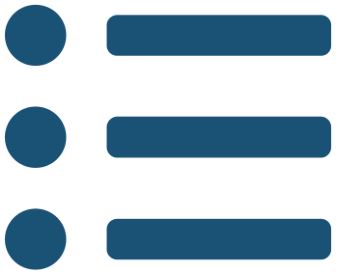
In this chapter
IN THIS CHAPTER
7.1
The Goal Is Generalisation
p. 52 ›
7.2
Underfitting and Overfitting
p. 52 ›
7.3
The Bias–Variance Decomposition
p. 53 ›
7.4
Noisy Data
p. 54 ›
7.5
Diagnosing With Learning Curves
p. 55 ›
7.6
Regularisation
p. 55 ›
7.7
Model Selection With Cross-Validation
p. 56 ›
Machine Learning · Chapter 7 · Overfitting, Bias–Variance and Regularisation
Handout pp. 52–59 5
Notes:
The route through the chapter. Each row is a link: click it to jump to that section in the slide show.

Slide 6

The Goal Is Generalisation
KEY IDEA
A model’s training error is its error on the examples it learned from. Its true error is its expected error on new examples drawn from the same source — the only error anybody cares about. The difference between the two is the generalisation gap. Training error is easy to measure and always optimistic; true error cannot be measured at all, only estimated on data the model has never seen. Everything in this chapter follows from taking that distinction seriously.
Machine Learning · Chapter 7 · Overfitting, Bias–Variance and Regularisation
§7.1 · Handout p. 52 6
Notes:
Say this in your own words first; the slide is the handout's wording.

Slide 7
Underfitting and Overfitting
SECTION 2 OF 7
7.2
7.1 The Goal Is Generalisation
7.2 Underfitting and Overfitting
7.3 The Bias–Variance Decomposition
7.4 Noisy Data
7.5 Diagnosing With Learning Curves
7.6 Regularisation
7.7 Model Selection With Cross-Validation
Machine Learning · Chapter 7
Handout §7.2 7
Notes:
Pause. Name the question this section answers.

Slide 8
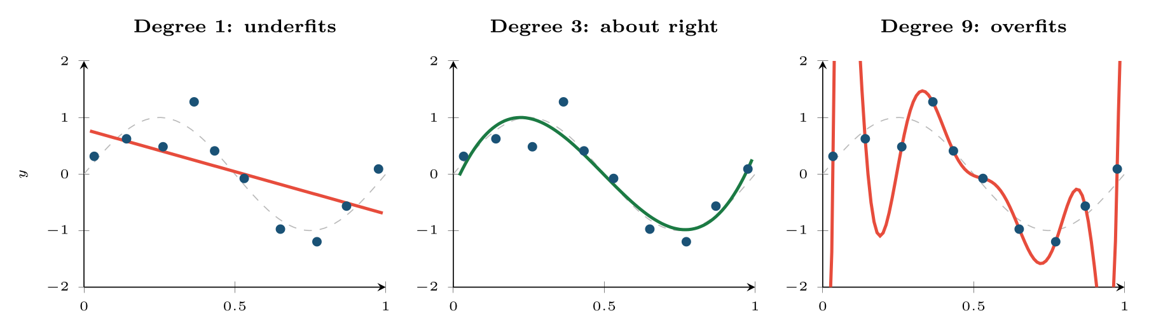
Underfitting and Overfitting
FIGURE 7.1
Three polynomials fitted to the same ten points (blue); the dashed curve is the true function. Training error falls from left to right and reaches zero at degree 9, which is nonetheless the worst of the three on new data.
Machine Learning · Chapter 7 · Overfitting, Bias–Variance and Regularisation
§7.2 · Handout p. 52 8
Notes:
Figure 7.1 fits polynomials of three degrees to the same ten noisy samples of a sine wave. Degree 1 is too rigid to follow the curve at all. Degree 9 has ten coefficients for ten points, so it passes through every one of them — training error exactly zero — and swings wildly between them. Degree 3 follows the shape and ignores the noise.
Figure 7.1 (handout p. 53): Three polynomials fitted to the same ten points (blue); the dashed curve is the true function. Training error falls from left to right and reaches zero at degree 9, which is nonetheless the worst of the three on new data.

Slide 9

Underfitting and Overfitting
DEFINITION
A model underfits when it is too simple to capture the pattern: both training and test error are high. A model overfits when it captures the noise in its particular training sample as well as the pattern: training error is low, test error is high, and the gap between them is large.
Machine Learning · Chapter 7 · Overfitting, Bias–Variance and Regularisation
§7.2 · Handout p. 52 9
Notes:
Read the box aloud, then ask for an example from the room before moving on.

Slide 10
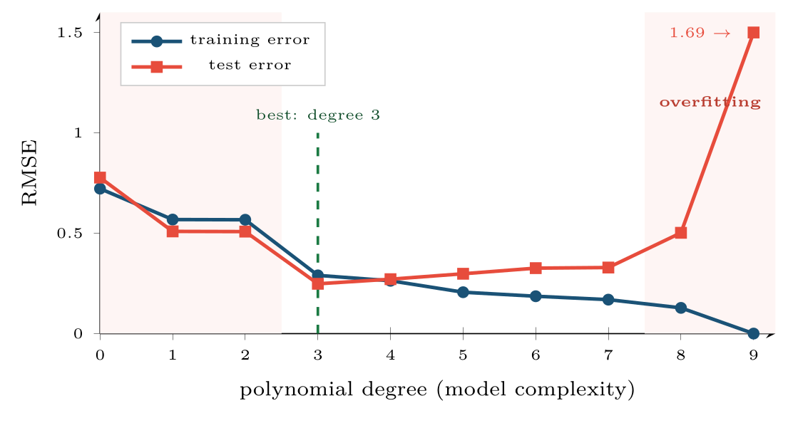
Underfitting and Overfitting
FIGURE 7.2
Training and test error for the polynomials of Figure 7.1, degree 0 to 9, with the test error measured on 2,000 fresh samples. Training error only ever falls; test error falls, bottoms out, and rises. The shape of that second curve is the whole of this chapter.
Machine Learning · Chapter 7 · Overfitting, Bias–Variance and Regularisation
§7.2 · Handout p. 52 10
Notes:
Figure 7.2 (handout p. 53): Training and test error for the polynomials of Figure 7.1, degree 0 to 9, with the test error measured on 2,000 fresh samples. Training error only ever falls; test error falls, bottoms out, and rises. The shape of that second curve is the whole of this chapter.

Slide 11
The Bias–Variance Decomposition
SECTION 3 OF 7
7.3
7.1 The Goal Is Generalisation
7.2 Underfitting and Overfitting
7.3 The Bias–Variance Decomposition
7.4 Noisy Data
7.5 Diagnosing With Learning Curves
7.6 Regularisation
7.7 Model Selection With Cross-Validation
Machine Learning · Chapter 7
Handout §7.3 11
Notes:
Pause. Name the question this section answers.

Slide 12
Bias, Variance and Noise
DEFINITION
For a fixed input x₀ with true value f(x₀), let f̂(x₀) be the prediction of a model trained on a random training set. Then the expected squared error on a new observation y = f(x₀) + ε is
Bias is how far the average prediction is from the truth — the error of the model’s assumptions. Variance is how much the prediction changes from one training set to another — its sensitivity to the particular sample. Noise is the irreducible error in the labels themselves, which no model can remove.
Machine Learning · Chapter 7 · Overfitting, Bias–Variance and Regularisation
§7.3 · Handout p. 53 12
Notes:
Why does test error rise again? Imagine repeating the whole experiment many times: draw a fresh training set, fit the model, predict at one fixed input x0. The predictions scatter. Their average may miss the truth, and they may be spread widely around their own average. Those are two different failings.

Slide 13
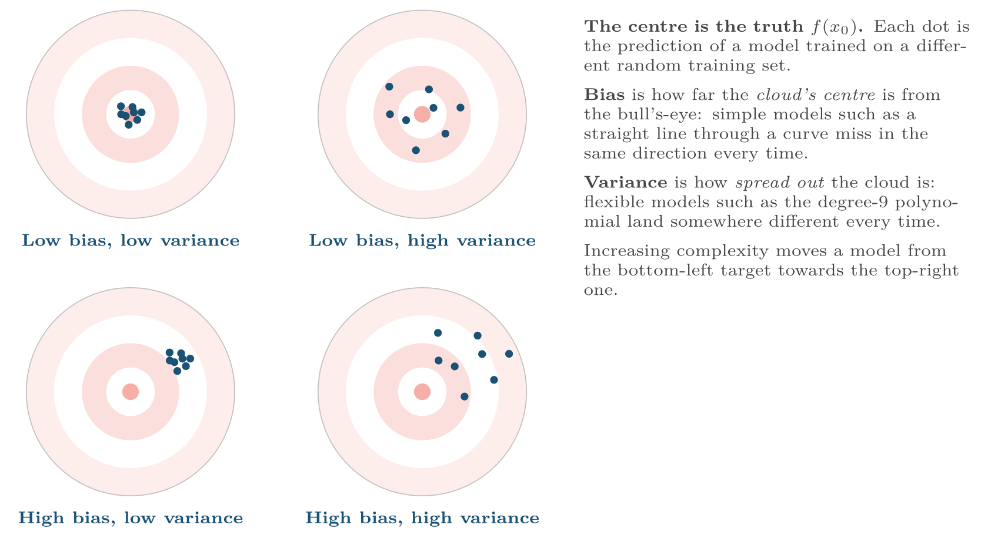
Bias and variance as target practice
FIGURE 7.3
The goal is the top-left target; in practice lowering one tends to raise the other.
Machine Learning · Chapter 7 · Overfitting, Bias–Variance and Regularisation
§7.3 · Handout p. 53 13
Notes:
Figure 7.3 (handout p. 54): Bias and variance as target practice. The goal is the top-left target; in practice lowering one tends to raise the other.

Slide 14

Bias and Variance From Four Training Sets
WORKED EXAMPLE
The true value at x₀ is f(x₀) = 5, and the label noise has variance σ²_{ε} = 1. Two models are each trained on the same four random training sets and predict at x₀:
• Simple model: 3.8, 4.2, 4.0, 4.0. Mean 4.0. bias² = (4.0 − 5)² = 1.00; variance = (0.04 + 0.04 + 0 + 0)/4 = 0.02.
• Complex model: 6.5, 3.4, 5.9, 4.2. Mean 5.0. bias² = 0; variance = (2.25 + 2.56 + 0.81 + 0.64)/4 = 1.565.
Expected squared error = bias² + variance + noise:
• simple: 1.00 + 0.02 + 1 = 2.02
• complex: 0 + 1.565 + 1 = 2.57
The biased model wins. It is wrong on average, but consistently so; the unbiased model is right on average and wrong every single time. And neither can go below 1.0 — that is the noise.
Machine Learning · Chapter 7 · Overfitting, Bias–Variance and Regularisation
§7.3 · Handout p. 53 14
Notes:
Each click adds one step of the working. Ask for the next number before you reveal it.

Slide 15

The Trade-Off
CONCEPT
Making a model more flexible lowers its bias and raises its variance; making it more rigid does the reverse. Test error is their sum plus noise, so it is U-shaped in complexity (Figure 7.2). The practical question is never “how do I eliminate bias?” or “how do I eliminate variance?” but “where is the bottom of the U, for this much data?” — because more data lowers variance and moves the bottom to the right.
Machine Learning · Chapter 7 · Overfitting, Bias–Variance and Regularisation
§7.3 · Handout p. 53 15
Notes:
Read the box aloud, then ask for an example from the room before moving on.

Slide 16
Noisy Data
KEY IDEA
Noise is not only measurement error in the features. It is also label noise: a student recorded as failing who in fact withdrew, an intrusion alert closed as benign by a tired analyst. Noise sets the floor on achievable error, and it is exactly what an overfitting model memorises. Two consequences follow. First, a training error far below the noise level is a symptom, not an achievement — the model has fitted the noise. Second, the noisier the data, the simpler the model it will support: every method in Part III has a setting (tree depth and pruning, k in nearest neighbours, C in an SVM) whose job is to stop it chasing noise.
Machine Learning · Chapter 7 · Overfitting, Bias–Variance and Regularisation
§7.4 · Handout p. 54 16
Notes:
Say this in your own words first; the slide is the handout's wording.

Slide 17
Diagnosing With Learning Curves
SECTION 5 OF 7
7.5
7.1 The Goal Is Generalisation
7.2 Underfitting and Overfitting
7.3 The Bias–Variance Decomposition
7.4 Noisy Data
7.5 Diagnosing With Learning Curves
7.6 Regularisation
7.7 Model Selection With Cross-Validation
Machine Learning · Chapter 7
Handout §7.5 17
Notes:
Pause. Name the question this section answers.

Slide 18
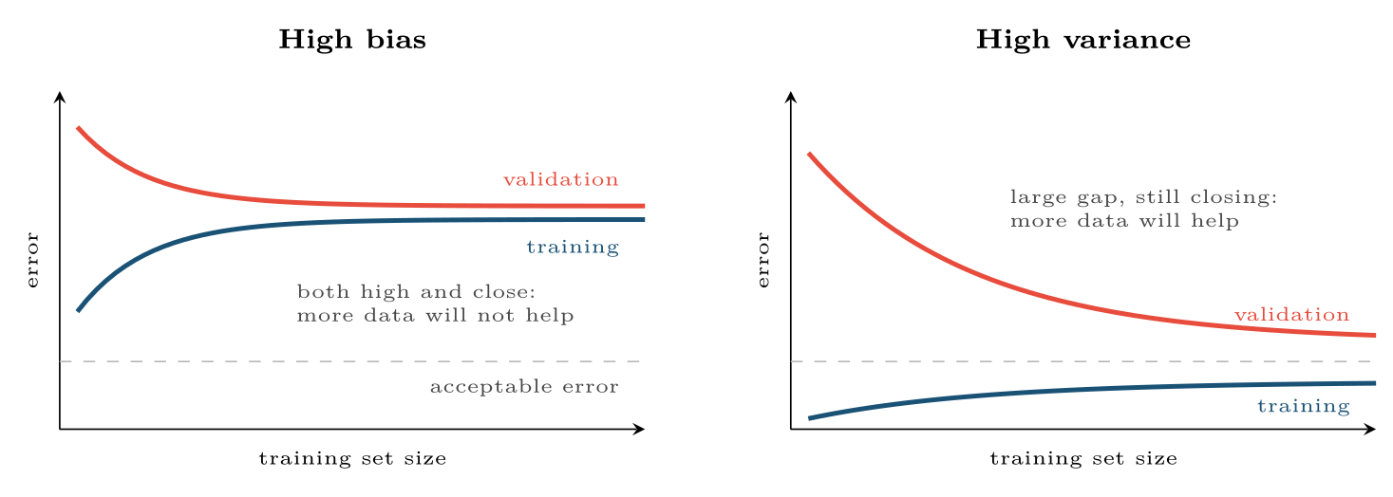
Learning curves
FIGURE 7.4
With high bias the curves meet early at an unacceptable level; with high variance there is a wide gap that more data would narrow.
Machine Learning · Chapter 7 · Overfitting, Bias–Variance and Regularisation
§7.5 · Handout p. 55 18
Notes:
A learning curve plots training and validation error against the number of training examples. Its shape tells you which of bias and variance is the problem, and therefore what to do.
Figure 7.4 (handout p. 55): Learning curves. With high bias the curves meet early at an unacceptable level; with high variance there is a wide gap that more data would narrow.

Slide 19

Diagnosing With Learning Curves
AT A GLANCE
Diagnosis | Symptom | What helps
High bias (underfitting) | Training error high; validation close to it | A more flexible model; more or better features; less regularisation. More data does not help
High variance (overfitting) | Training error low; validation much higher | More data; fewer features; a simpler model; more regularisation; ensembles that average (Chapter 14)
Both fine but still poor | Both curves meet at the noise level | Better data: cleaner labels, more informative features. The algorithm is not the problem
Machine Learning · Chapter 7 · Overfitting, Bias–Variance and Regularisation
§7.5 · Handout p. 55 19
Notes:
Do not read the table row by row: pick the row the room is most likely to get wrong and ask why.

Slide 20
Regularisation
SECTION 6 OF 7
7.6
7.1 The Goal Is Generalisation
7.2 Underfitting and Overfitting
7.3 The Bias–Variance Decomposition
7.4 Noisy Data
7.5 Diagnosing With Learning Curves
7.6 Regularisation
7.7 Model Selection With Cross-Validation
Machine Learning · Chapter 7
Handout §7.6 20
Notes:
Pause. Name the question this section answers.

Slide 21
Ridge and Lasso
DEFINITION
Add a penalty on the size of the weights to the training loss:
The hyperparameter λ ≥ 0 sets the strength: λ = 0 is ordinary least squares; a very large λ forces every weight to 0 (the bias b is not penalised). Ridge shrinks all weights smoothly; lasso drives some of them to exactly zero, so it also selects features. Features must be standardised first, or the penalty falls unequally on them.
Machine Learning · Chapter 7 · Overfitting, Bias–Variance and Regularisation
§7.6 · Handout p. 55 21
Notes:
Choosing a lower polynomial degree is one way to control complexity, but a crude one: the degree jumps in whole steps. Regularisation controls it smoothly, by keeping the high-degree terms but charging the model for large weights.

Slide 22
Ridge Shrinkage in One Dimension
WORKED EXAMPLE
Centred data x = −2, −1, 0, 1, 2 and y = −3, −1, 0, 2, 2, fitted by ŷ = wx. Minimising Σ(y_{i} − wx_{i})² + λ w² gives
• λ = 0: w = 13/10 = 1.30 (least squares).
• λ = 2: w = 13/12 = 1.08.
• λ = 10: w = 13/20 = 0.65.
The penalty adds λ to the denominator, so it pulls the weight towards zero — a little when the data is plentiful (Σ x² large), a lot when it is not. That is exactly the behaviour wanted: shrink hardest where the data says least.
Machine Learning · Chapter 7 · Overfitting, Bias–Variance and Regularisation
§7.6 · Handout p. 55 22
Notes:
Each click adds one step of the working. Ask for the next number before you reveal it.

Slide 23
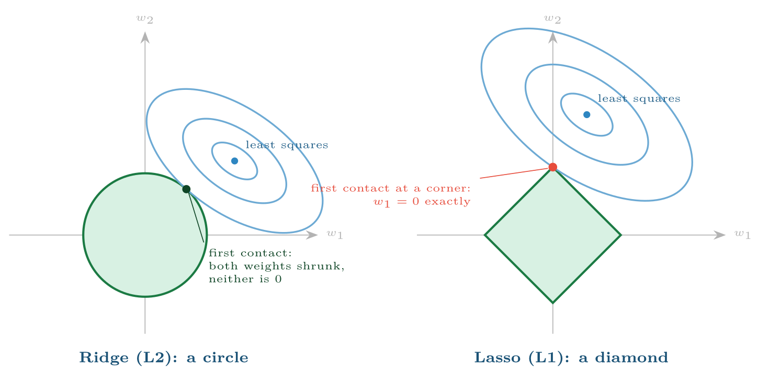
Why lasso sets weights to zero
FIGURE 7.5
The regularised solution is where the smallest error ellipse (blue) first touches the region allowed by the penalty (green). A circle is touched at a generic point; a diamond is usually touched at a corner, where one weight is exactly zero.
Machine Learning · Chapter 7 · Overfitting, Bias–Variance and Regularisation
§7.6 · Handout p. 55 23
Notes:
Figure 7.5 (handout p. 56): Why lasso sets weights to zero. The regularised solution is where the smallest error ellipse (blue) first touches the region allowed by the penalty (green). A circle is touched at a generic point; a diamond is usually touched at a corner, where one weight is exactly zero.

Slide 24

Regularisation Is Everywhere, Under Other Names
WATCH OUT
Every flexible model in this course has a knob that trades variance for bias. Maximum tree depth and pruning (Chapter 9); k in k-nearest neighbours (Chapter 11); C in SVMs (Chapter 12); weight decay, early stopping and dropout in neural networks (Chapter 13); C = 1/λ in scikit-learn’s LogisticRegression (Chapter 6). Once you see them as the same idea, tuning them is the same procedure — the one in the next section.
Machine Learning · Chapter 7 · Overfitting, Bias–Variance and Regularisation
§7.6 · Handout p. 55 24
Notes:
Read the box aloud, then ask for an example from the room before moving on.

Slide 25
Model Selection With Cross-Validation
SECTION 7 OF 7
7.7
7.1 The Goal Is Generalisation
7.2 Underfitting and Overfitting
7.3 The Bias–Variance Decomposition
7.4 Noisy Data
7.5 Diagnosing With Learning Curves
7.6 Regularisation
7.7 Model Selection With Cross-Validation
Machine Learning · Chapter 7
Handout §7.7 25
Notes:
Pause. Name the question this section answers.

Slide 26
k-Fold Cross-Validation
DEFINITION
Split the training data into k equal folds (typically 5 or 10). For each fold in turn, train on the other k − 1 folds and measure error on the held-out fold. The cross-validation score is the mean of the k errors; report their standard deviation too. Every example is used for validation exactly once.
Machine Learning · Chapter 7 · Overfitting, Bias–Variance and Regularisation
§7.7 · Handout p. 56 26
Notes:
A hyperparameter is a setting chosen before training — degree, λ, k, tree depth — as opposed to a parameter such as a weight, which training sets. Hyperparameters are chosen by validation error. With little data a single validation split is too noisy to trust, so it is replaced by cross-validation.

Slide 27
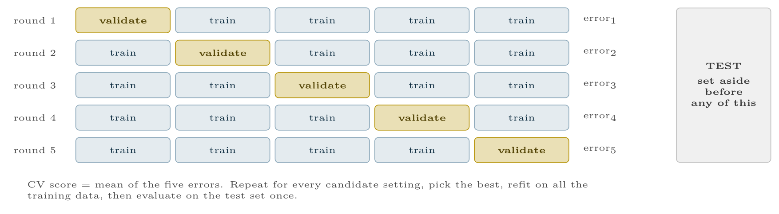
Five-fold cross-validation on the training data
FIGURE 7.6
The test set is not part of the rotation.
Machine Learning · Chapter 7 · Overfitting, Bias–Variance and Regularisation
§7.7 · Handout p. 56 27
Notes:
Figure 7.6 (handout p. 57): Five-fold cross-validation on the training data. The test set is not part of the rotation.

Slide 28
Choosing λ by Cross-Validation
WORKED EXAMPLE
Five-fold cross-validation of a degree-12 polynomial with ridge penalties, from this chapter’s lab:
λ | CV RMSE
10⁻⁶ | 0.388
10⁻³ | 0.326 | ← lowest
10⁻¹ | 0.330
10 | 0.441
1000 | 0.706
The U-shape again: too little penalty overfits, too much underfits. Choose λ = 10⁻³, refit on the whole training set, and only then measure the test set: RMSE 0.299. Unregularised, the same degree-12 polynomial had a CV RMSE of 2.14 — regularisation, not a lower degree, rescued it.
Notice that 10⁻³ and 10⁻¹ are within 0.004 of each other, far less than the fold-to-fold variation. When candidates are this close, prefer the simpler model — here the larger penalty.
Machine Learning · Chapter 7 · Overfitting, Bias–Variance and Regularisation
§7.7 · Handout p. 56 28
Notes:
Each click adds one step of the working. Ask for the next number before you reveal it.

Slide 29
Tuning on the Test Set Is Still Cheating When a Library Does It
WATCH OUT
If you try thirty settings and report the best test score, the test set has become a validation set and the score is optimistic. Tune with cross-validation on the training data (GridSearchCV does this), then use the test set once. When even the tuning procedure must be evaluated honestly — for a published comparison — wrap the whole search in an outer cross-validation loop: nested cross-validation.
Machine Learning · Chapter 7 · Overfitting, Bias–Variance and Regularisation
§7.7 · Handout p. 56 29
Notes:
Read the box aloud, then ask for an example from the room before moving on.

Slide 30

Common pitfalls
COMMON PITFALLS
✕
Celebrating zero training error. With noisy labels it proves overfitting.
✕
Collecting more data to cure high bias. If training error is already high, more of the same data will not lower it.
✕
Regularising unscaled features. The penalty then depends on the units each feature happens to be measured in.
✕
Reporting the best of many test scores. Select on cross-validation; test once.
✕
Choosing between near-identical CV scores. Differences smaller than the fold-to-fold standard deviation are noise.
Machine Learning · Chapter 7 · Overfitting, Bias–Variance and Regularisation
§7.7 · Handout p. 56 30
Notes:
For each pitfall, ask who has seen it happen. One real story beats five bullets.

Slide 31





Four lenses: Bias and Variance
FOUR LENSES
LEARNING ANALYTICS
PROJECT MANAGEMENT
A dropout model trained on one cohort of 200 students is a high-variance model: retrained on next year’s cohort it gives different students different risks.
Effort data from one team is tiny and noisy, so the right model is nearly always simpler than it looks.
INTERNET OF THINGS
CYBERSECURITY
Vibration data is plentiful but each machine is different.
An intrusion model that fits last month’s traffic perfectly has learned last month’s attacks, including their noise.
Machine Learning · Chapter 7 · Overfitting, Bias–Variance and Regularisation
Handout p. 59 31
Notes:
The same method, four domains. Each of the next four slides opens one lens in full.

Slide 32

Learning Analytics: Bias and Variance
FOUR LENSES
LEARNING ANALYTICS
Project Management
A dropout model trained on one cohort of 200 students is a high-variance model: retrained on next year’s cohort it gives different students different risks. Strong regularisation and a small number of well-understood features usually beat a flexible model here, because the data is small and the cohorts drift.
Internet of Things
Cybersecurity
Machine Learning · Chapter 7 · Overfitting, Bias–Variance and Regularisation
Handout p. 59 32
Notes:
Learning Analytics. A dropout model trained on one cohort of 200 students is a high-variance model: retrained on next year’s cohort it gives different students different risks. Strong regularisation and a small number of well-understood features usually beat a flexible model here, because the data is small and the cohorts drift.

Slide 33

Project Management: Bias and Variance
FOUR LENSES
PROJECT MANAGEMENT
Learning Analytics
Effort data from one team is tiny and noisy, so the right model is nearly always simpler than it looks. A regression with two features that generalises beats one with twenty that fits last quarter perfectly; learning curves on project data usually show high variance.
Internet of Things
Cybersecurity
Machine Learning · Chapter 7 · Overfitting, Bias–Variance and Regularisation
Handout p. 59 33
Notes:
Project Management. Effort data from one team is tiny and noisy, so the right model is nearly always simpler than it looks. A regression with two features that generalises beats one with twenty that fits last quarter perfectly; learning curves on project data usually show high variance.

Slide 34

Internet of Things: Bias and Variance
FOUR LENSES
INTERNET OF THINGS
Learning Analytics
Vibration data is plentiful but each machine is different. A model with low variance across machines — tested by holding out whole machines in cross-validation, not random readings — is worth more than one that is very accurate on the machines it was trained on.
Project Management
Cybersecurity
Machine Learning · Chapter 7 · Overfitting, Bias–Variance and Regularisation
Handout p. 59 34
Notes:
Internet of Things. Vibration data is plentiful but each machine is different. A model with low variance across machines — tested by holding out whole machines in cross-validation, not random readings — is worth more than one that is very accurate on the machines it was trained on.

Slide 35

Cybersecurity: Bias and Variance
FOUR LENSES
CYBERSECURITY
Learning Analytics
An intrusion model that fits last month’s traffic perfectly has learned last month’s attacks, including their noise. Overfitting here is also a security weakness: a model that memorises exact signatures is evaded by the smallest variation. Regularised, simpler models degrade more gracefully.
Project Management
Internet of Things
Machine Learning · Chapter 7 · Overfitting, Bias–Variance and Regularisation
Handout p. 59 35
Notes:
Cybersecurity. An intrusion model that fits last month’s traffic perfectly has learned last month’s attacks, including their noise. Overfitting here is also a security weakness: a model that memorises exact signatures is evaded by the smallest variation. Regularised, simpler models degrade more gracefully.

Slide 36

Try it yourself: Find the Bottom of the U
TRY IT YOURSELF
WHAT YOU WILL DO
1. Noisy samples of a sine wave
2. Complexity: training error against cross-validated error
3. Keep degree 12, but regularise; choose alpha by CV
4. Only now, once: the test set
THIS WEEK'S LAB
WHAT YOU WILL RUN
RUNNABLE COPY
Week 6: Find the bottom of the U
1 listing, 38 lines of Python
code/ch07_find_bottom_u.py
Machine Learning · Chapter 7 · Overfitting, Bias–Variance and Regularisation
§7.7 · Handout p. 56 36
Notes:
Say what the room will have at the end of the lab, then let them start. Circulate rather than lecture.

Slide 37
Find the Bottom of the U
LAB · STEP 1 OF 5
Set-up
Python · code/ch07_find_bottom_u.py
2
3
4
5
6
7
import numpy as np
from sklearn.pipeline import make_pipeline
from sklearn.preprocessing import PolynomialFeatures, StandardScaler
from sklearn.linear_model import LinearRegression, Ridge
from sklearn.model_selection import (train_test_split, KFold,
cross_val_score, GridSearchCV)
Machine Learning · Chapter 7 · Overfitting, Bias–Variance and Regularisation
§7.7 · Handout p. 56 37
Notes:
Step 1: Set-up. Read the code aloud; ask what each line would print before running it.

Slide 38
Find the Bottom of the U
LAB · STEP 2 OF 5
Noisy samples of a sine wave
Python · code/ch07_find_bottom_u.py
9
10
11
12
13
14
15
16
# --- noisy samples of a sine wave ----------------------------------------
rng = np.random.default_rng(0)
X = rng.uniform(0, 1, (60, 1))
y = np.sin(2 * np.pi * X[:, 0]) + rng.normal(0, 0.25, 60)
X_tr, X_te, y_tr, y_te = train_test_split(X, y, test_size=0.25,
random_state=0)
cv = KFold(5, shuffle=True, random_state=0)
rmse = "neg_root_mean_squared_error"
Machine Learning · Chapter 7 · Overfitting, Bias–Variance and Regularisation
§7.7 · Handout p. 56 38
Notes:
Step 2: Noisy samples of a sine wave. Read the code aloud; ask what each line would print before running it.

Slide 39
Find the Bottom of the U
LAB · STEP 3 OF 5
Complexity: training error against cross-validated error
Python · code/ch07_find_bottom_u.py
18
19
20
21
22
23
24
25
26
# --- 1. complexity: training error against cross-validated error ---------
for deg in (1, 3, 6, 12):
m = make_pipeline(PolynomialFeatures(deg), StandardScaler(),
LinearRegression())
m.fit(X_tr, y_tr)
train = np.sqrt(np.mean((m.predict(X_tr) - y_tr) ** 2))
cvs = -cross_val_score(m, X_tr, y_tr, cv=cv, scoring=rmse)
print(f"degree {deg:2d}: train RMSE {train:.3f} "
f"CV RMSE {cvs.mean():.3f} +/- {cvs.std():.3f}")
Machine Learning · Chapter 7 · Overfitting, Bias–Variance and Regularisation
§7.7 · Handout p. 56 39
Notes:
Step 3: Complexity: training error against cross-validated error. Read the code aloud; ask what each line would print before running it.

Slide 40
Find the Bottom of the U
LAB · STEP 4 OF 5
Keep degree 12, but regularise; choose alpha by CV
Python · code/ch07_find_bottom_u.py
28
29
30
31
32
33
34
35
# --- 2. keep degree 12, but regularise; choose alpha by CV ---------------
pipe = make_pipeline(PolynomialFeatures(12), StandardScaler(), Ridge())
grid = GridSearchCV(pipe, {"ridge__alpha": [1e-6, 1e-3, 1e-1, 10, 1000]},
cv=cv, scoring=rmse).fit(X_tr, y_tr)
for a, s in zip(grid.cv_results_["param_ridge__alpha"],
grid.cv_results_["mean_test_score"]):
print(f"alpha {a:>8g}: CV RMSE {-s:.3f}")
print("chosen:", grid.best_params_)
Machine Learning · Chapter 7 · Overfitting, Bias–Variance and Regularisation
§7.7 · Handout p. 56 40
Notes:
Step 4: Keep degree 12, but regularise; choose alpha by CV. Read the code aloud; ask what each line would print before running it.

Slide 41
Find the Bottom of the U
LAB · STEP 5 OF 5
Only now, once: the test set
Python · code/ch07_find_bottom_u.py
37
38
39
# --- 3. only now, once: the test set -------------------------------------
pred = grid.predict(X_te)
print("test RMSE:", round(float(np.sqrt(np.mean((pred - y_te) ** 2))), 3))
Machine Learning · Chapter 7 · Overfitting, Bias–Variance and Regularisation
§7.7 · Handout p. 56 41
Notes:
Step 5: Only now, once: the test set. Read the code aloud; ask what each line would print before running it.

Slide 42
What the lab shows
TRY IT YOURSELF
scikit-learn calls λ alpha. Change the 60 samples to 600 and run again: which degrees stop overfitting, and why?
Machine Learning · Chapter 7 · Overfitting, Bias–Variance and Regularisation
§7.7 · Handout p. 56 42
Notes:
Read the box aloud, then ask for an example from the room before moving on.

Slide 43

A model has training RMSE 0.05 and validation RMSE 0.90. Is the problem bias or variance? Name two remedies.
CHECKPOINT 1 OF 3
Discuss with the person next to you, then advance.
Machine Learning · Chapter 7 · Overfitting, Bias–Variance and Regularisation
Handout p. 59 · answers in Appendix D 43
Notes:
Ask the room. Do not advance until someone commits to an answer.

Slide 44

A model has training RMSE 0.05 and validation RMSE 0.90. Is the problem bias or variance? Name two remedies.
CHECKPOINT 1 OF 3 · ANSWER
Variance (overfitting). Remedies: more data, stronger regularisation or a simpler model, fewer features, early stopping, an averaging ensemble.
Machine Learning · Chapter 7 · Overfitting, Bias–Variance and Regularisation
Handout p. 59 · answers in Appendix D 44
Notes:
Answer (Appendix D): Variance (overfitting). Remedies: more data, stronger regularisation or a simpler model, fewer features, early stopping, an averaging ensemble.

Slide 45
Ten models trained on different samples predict 2, 2, 2, 2, 2, 2, 2, 2, 2, 2 at a point whose true value is 3. Give the bias² and the variance.
CHECKPOINT 2 OF 3
Discuss with the person next to you, then advance.
Machine Learning · Chapter 7 · Overfitting, Bias–Variance and Regularisation
Handout p. 59 · answers in Appendix D 45
Notes:
Ask the room. Do not advance until someone commits to an answer.

Slide 46
Ten models trained on different samples predict 2, 2, 2, 2, 2, 2, 2, 2, 2, 2 at a point whose true value is 3. Give the bias² and the variance.
CHECKPOINT 2 OF 3 · ANSWER
Bias² = (2 − 3)² = 1. Variance = 0: every prediction is identical.
Machine Learning · Chapter 7 · Overfitting, Bias–Variance and Regularisation
Handout p. 59 · answers in Appendix D 46
Notes:
Answer (Appendix D): Bias2 = (2 − 3)2 = 1. Variance = 0: every prediction is identical.

Slide 47
Why does lasso, but not ridge, perform feature selection?
CHECKPOINT 3 OF 3
Discuss with the person next to you, then advance.
Machine Learning · Chapter 7 · Overfitting, Bias–Variance and Regularisation
Handout p. 59 · answers in Appendix D 47
Notes:
Ask the room. Do not advance until someone commits to an answer.

Slide 48
Why does lasso, but not ridge, perform feature selection?
CHECKPOINT 3 OF 3 · ANSWER
The L1 constraint region is a diamond with corners on the axes; the error contours usually first touch it at a corner, where some weights are exactly zero. The L2 region is a circle with no corners, so weights shrink but rarely reach zero.
Machine Learning · Chapter 7 · Overfitting, Bias–Variance and Regularisation
Handout p. 59 · answers in Appendix D 48
Notes:
Answer (Appendix D): The L1 constraint region is a diamond with corners on the axes; the error contours usually first touch it at a corner, where some weights are exactly zero. The L2 region is a circle with no corners, so weights shrink but rarely reach zero.

Slide 49

What to take away
CHAPTER SUMMARY
1
Training error is optimistic; generalisation is judged on unseen data.
2
Underfitting: both errors high. Overfitting: training error low, test error high. Test error is U-shaped in model complexity.
3
Expected error = bias² + variance + noise. Flexibility trades bias for variance; noise is a floor no model can go below.
4
Learning curves diagnose the problem: converged and high means bias; a wide, closing gap means variance.
5
Ridge (L2) shrinks weights; lasso (L1) also sets some to zero. The penalty strength is a hyperparameter.
6
Choose hyperparameters by k-fold cross-validation on the training data, refit, then test once.
Machine Learning · Chapter 7 · Overfitting, Bias–Variance and Regularisation
Handout p. 59 49
Notes:
Ask the room to say each takeaway before you reveal it.

Slide 50

Quick check 1 of 3
REVIEW · MULTIPLE CHOICE
Adding training data is most useful when a model has:
A
high bias
B
high variance
C
high noise
D
low variance
Machine Learning · Chapter 7 · Overfitting, Bias–Variance and Regularisation
Handout p. 59 50
Notes:
Take a show of hands for each option before discussing. (The handout does not print MCQ answers.)

Slide 51
Quick check 2 of 3
REVIEW · MULTIPLE CHOICE
As λ in ridge regression increases:
A
bias and variance both fall
B
bias rises and variance falls
C
bias falls and variance rises
D
neither changes
Machine Learning · Chapter 7 · Overfitting, Bias–Variance and Regularisation
Handout p. 59 51
Notes:
Take a show of hands for each option before discussing. (The handout does not print MCQ answers.)

Slide 52
Quick check 3 of 3
REVIEW · MULTIPLE CHOICE
Which of these is a hyperparameter?
A
a regression weight
B
the bias term b
C
the number of folds’ mean error
D
the degree of a polynomial
Machine Learning · Chapter 7 · Overfitting, Bias–Variance and Regularisation
Handout p. 59 52
Notes:
Take a show of hands for each option before discussing. (The handout does not print MCQ answers.)

Slide 53
For your notebook
REVIEW QUESTIONS
SHORT
Explain why training error cannot be used to choose the degree of a polynomial.
SHORT
What is irreducible error, and why can no model remove it?
SHORT
Describe nested cross-validation and when it is needed.
APPLIED
Three models predict at a point with true value 10 and noise variance 4. Over five training sets they predict: A: 8, 8, 9, 8, 7; B: 12, 7, 10, 13, 8; C: 10, 10, 11, 9, 10. Compute bias², variance and expected error for each, and rank them.
APPLIED
For the centred data x = −1, 0, 1, 2 (centre it first) and y = 1, 2, 2, 5 (centre it too), compute the ridge weight for λ = 0, 1, 5 and describe the pattern.
Machine Learning · Chapter 7 · Overfitting, Bias–Variance and Regularisation
Handout p. 59 53
Notes:
Set these for independent study. Model answers are not printed in the handout.

Slide 54
End of Chapter 7
07
NEXT
READ
Chapter 8 — Measuring Classifier Performance
Handout Chapter 7, pages 52–59
THIS WEEK'S LAB
Find the bottom of the U
Machine Learning · Chapter 7 · Overfitting, Bias–Variance and Regularisation
54
Notes:
Close. NEXT: Chapter 8 — Measuring Classifier Performance. READ: Handout Chapter 7, pages 52–59. THIS WEEK'S LAB: Find the bottom of the U.

